Slide 1
Storage and File Structure
Sumber: Silberschatz, Korth and Sudarshan, Database System Concepts, 6th Ed.
D. Grosshans, File Systems Design and Implementation
Program Studi Teknik Informatika
Institut Teknologi Bandung
Notes:
Himpunan data yg diatur sedemikian rupa.
Butuh cara supaya bisa diatur dg efektif, efisien.

Slide 2
Learning Outcomes
IT
Explain the concepts of records, record types, and files
Explain the different techniques for placing records on file
Explain how index can improve performance
Give examples of the application of primary, secondary, and clustering indexes

Slide 3
Outline
Mekanisme kerja magnetic disk
Peran Buffer Manager
Cara akses secondary storage
Organisasi file

Slide 4
Mekanisme kerja magnetic disk

Slide 5

Storage Hierarchy
primary storage: Fastest media but volatile (cache, main memory).
secondary storage: next level in hierarchy, non-volatile, moderately fast access time
also called on-line storage
E.g. flash memory, magnetic disks
tertiary storage: lowest level in hierarchy, non-volatile, slow access time
also called off-line storage
E.g. magnetic tape, optical storage

Slide 6
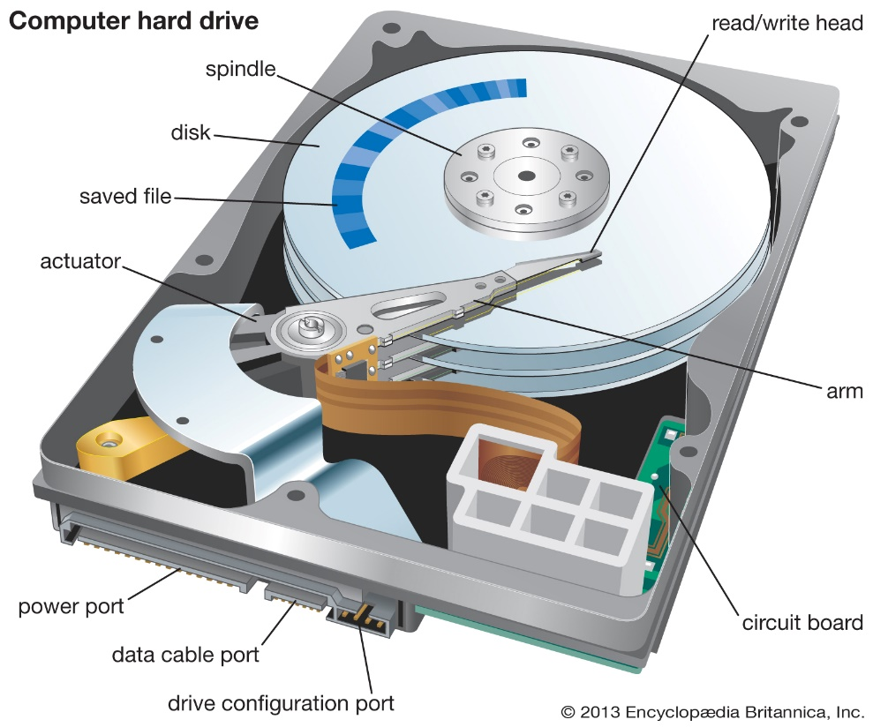
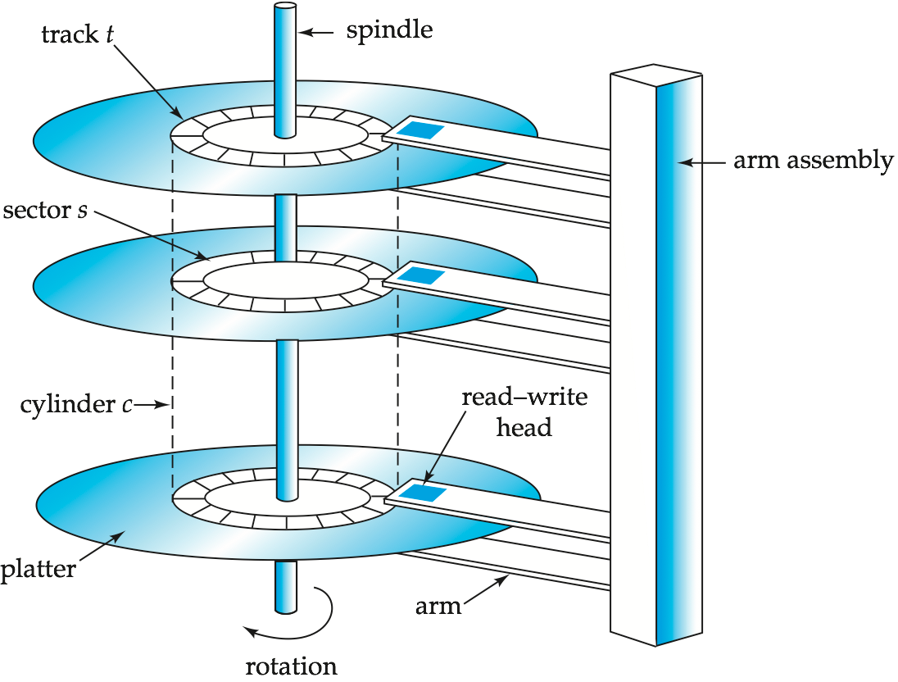
Magnetic Hard Disk Mechanism
NOTE: Diagram is schematic, and simplifies the structure of actual disk drives
Notes:
cylinder : tumpukan plat/piring

Slide 7
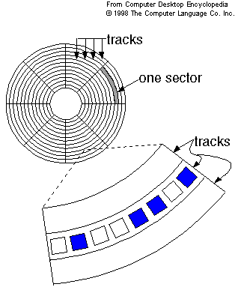
Magnetic Hard Disk Tracks and Sectors
Surface of platter divided into circular tracks
Over 50K-100K tracks per platter on typical hard disks
Each track is divided into sectors.
A sector is the smallest unit of data that can be read or written.
Sector size typically 512 bytes
Typical sectors per track: 500 to 1000 (on inner tracks) to 1000 to 2000 (on outer tracks)
Notes:
Surface = permukaan

Slide 8
Magnetic Disks
Read-write head
Positioned very close to the platter surface (almost touching it)
Reads or writes magnetically encoded information.
To read/write a sector
disk arm swings to position head on right track
platter spins continually; data is read/written as sector passes under head
Head-disk assemblies
multiple disk platters on a single spindle (1 to 5 usually)
one head per platter, mounted on a common arm.
Cylinder i consists of i^{th} track of all the platters
Notes:
Spindle = poros (tengah) hdd, tempat piring bias muter
Untuk baca tulis dia akan berputar terus pada track yg sesuai
File Allocation tabel, menyimpan lokasi sebuah file itu dimana

Slide 9
Magnetic Disks (Cont.)
Disk controller – interfaces between the computer system and the actual disk drive hardware.
accepts high-level commands to read or write a sector
initiates actions such as moving the disk arm to the right track and actually reading or writing the data
Computes and attaches checksums to each sector to verify that data is read back correctly
If data is corrupted, with very high probability stored checksum won’t match recomputed checksum
Ensures successful writing by reading back sector after writing it
Performs remapping of bad sectors
Notes:
Disk controller diimplementasikan di dalam disk drive unit
Menerima perintah dari SO utk baca tulis
Menggerakkan disk arm ke track yg tepat
Mengatur ulang bad sector, memetakan. bisa recovery.

Slide 10
Performance Measures of Disks
Access time – the time it takes from when a read or write request is issued to when data transfer begins. Consists of:
Seek time – time it takes to reposition the arm over the correct track.
Average seek time is 1/2 the worst case seek time.
Would be 1/3 if all tracks had the same number of sectors, and we ignore the time to start and stop arm movement
4 to 10 milliseconds on typical disks
Rotational latency – time it takes for the sector to be accessed to appear under the head.
Average latency is 1/2 of the worst case latency.
4 to 11 milliseconds on typical disks (5400 to 15000 r.p.m.)
Data-transfer rate – the rate at which data can be retrieved from or stored to the disk.
25 to 100 MB per second max rate, lower for inner tracks
Multiple disks may share a controller, so rate that controller can handle is also important
Notes:
Access time = dari permintaan dating, sampai data siap di transfer
Average seek = setengah dari maksimum (worst case) seek time
Latensi = jeda waktu antara permintaan dan respon
Latensi Rotational = waktu yg dibutuhkan oleh sebuah sector utk dapat diakses

Slide 11
Performance Measures (Cont.)
Mean time to failure (MTTF) – the average time the disk is expected to run continuously without any failure.
Typically 3 to 5 years
Probability of failure of new disks is quite low, corresponding to a “theoretical MTTF” of 500,000 to 1,200,000 hours for a new disk
E.g., an MTTF of 1,200,000 hours for a new disk means that given 1000 relatively new disks, on an average one will fail every 1200 hours
MTTF decreases as disk ages

Slide 12
Disk-Block Access
Block – a contiguous sequence of sectors from a single track
data is transferred between disk and main memory in blocks
sizes range from 512 bytes to several kilobytes
Smaller blocks: more transfers from disk
Larger blocks: more space wasted due to partially filled blocks
Typical block sizes today range from 4 to 16 kilobytes
Notes:
1 block NTFS = 4KB,
FAT32 512 byte
1 block EXT3 = 1KB, 2KB, atau 4KB
EXT4 = 4KB

Slide 13
Peran Buffer Manager

Slide 14
Storage Access
A database file is partitioned into fixed-length storage units called blocks. Blocks are units of both storage allocation and data transfer.
Database system seeks to minimize the number of block transfers between the disk and memory. We can reduce the number of disk accesses by keeping as many blocks as possible in main memory.
Buffer – portion of main memory available to store copies of disk blocks.
Buffer manager – subsystem responsible for allocating buffer space in main memory.
Notes:
14
- Buffer = menampung sebanyak mungkin data di memori, supaya ga banyak operasi baca tulis disk.
- Waktu terlama pada proses adalah pada cari data dan transfer ke DISK

Slide 15
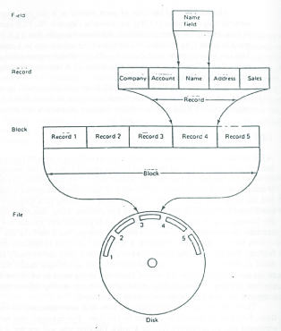
Fields, Records, and Files
Notes:
Field adalah kumpulan dari karakter yang membentuk satu arti, maka jika terdapat field misalnya seperti NomerBarang atau NamaBarang, maka yang dipaparkan dalam field tersebut harus yang berkaitan dengan nomer barang dan nama barang. Atau definisi field yang lainnya yaitu tempat atau kolom yang terdapat dalam suatu tabel untuk mengisikan nama-nama (data) field yang akan di isikan.
Record adalah kumpulan field yang sangat lengkap, dan biasanya dihitung dalam satuan baris. Tabel adalah merupakan kumpulan dari beberapa record dan juga field. File adalah terdiri dari record-record yang menggambarkan dari satu kesatuan data yang sejenis. Misalnya seperti file nama barang berisikan data tentang semua nama barang yang ada. Data adalah kumpulan fakta atau kejadian yang digunakan sebagai penyelesaian masalah dalam bentuk informasi. Pengertian basis data (database) adalah basis data yang terdiri dari dua kata, yaitu kata basis dan data. Basis dapat di artikan markas ataupun gudang, maupun tempat berkumpul

Slide 16
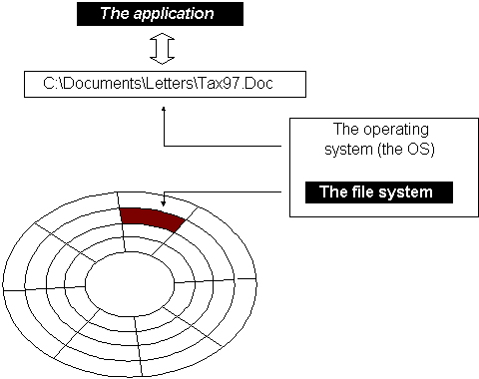
Disk-Block Transfer

Slide 17
Record Access Mechanism
User buffer
1 record
Main Memory
(elektronis)
per record
I/O Buffer
Storage
(mekanis)
1 block
per block
Block-1
Block-2

Slide 18
Optimization of Disk Block Access
Nonvolatile write buffers speed up disk writes by writing blocks to a non-volatile RAM buffer immediately
Non-volatile RAM: battery backed up RAM or flash memory
Even if power fails, the data is safe and will be written to disk when power returns
Controller then writes to disk whenever the disk has no other requests or request has been pending for some time
Database operations that require data to be safely stored before continuing can continue without waiting for data to be written to disk
Writes can be reordered to minimize disk arm movement
Notes:
Menghindari data yang hilang, maka hasil transaksi (update record) biasanya langsung ditulis di disk
Tapi ini biasanya membebani disk, karna DISK harus sering melakukan operasi
Solusinya pake NVRAM, hasil transaksi disimpan di NVRAM, NVRAM kasih tahu OS kalo data AMAN.
Begitu disk nganggur, maka data di NVRAM baru dipindah ke disk

Slide 19
Buffer Manager
Programs call on the buffer manager when they need a block from disk.
If the block is already in the buffer, buffer manager returns the address of the block in main memory
If the block is not in the buffer, the buffer manager
Allocates space in the buffer for the block
Replacing (throwing out) some other block, if required, to make space for the new block.
Replaced block written back to disk only if it was modified since the most recent time that it was written to/fetched from the disk.
Reads the block from the disk to the buffer, and returns the address of the block in main memory to requester.
Notes:
19

Slide 20
Buffer-Replacement Policies
Most operating systems replace the block least recently used (LRU strategy)
Idea behind LRU – use past pattern of block references as a predictor of future references
Queries have well-defined access patterns (such as sequential scans), and a database system can use the information in a user’s query to predict future references
LRU can be a bad strategy for certain access patterns involving repeated scans of data
For example: when computing the join of 2 relations r and s by a nested loops for each tuple tr of r do for each tuple ts of s do if the tuples tr and ts match …
Mixed strategy with hints on replacement strategy provided by the query optimizer is preferable
Notes:
20
Tujuan Buffer-Replacement Policies = meminimalkan akses disk, namun penggunaan BUFFER jg harus efisien.
least recently used = meramal mana tuple yg hendak digunakan
DBMS punya itung-itungan, kalo dia mau melakukan operasi tertentu, maka akan butuh block mana saja. Informasi ini yg dipakai utk memininmalkan disk access.

Slide 21
Buffer-Replacement Policies (Cont.)
Pinned block – memory block that is not allowed to be written back to disk.
Toss-immediate strategy – frees the space occupied by a block as soon as the final tuple of that block has been processed
Most recently used (MRU) strategy – system must pin the block currently being processed. After the final tuple of that block has been processed, the block is unpinned, and it becomes the most recently used block.
Buffer manager can use statistical information regarding the probability that a request will reference a particular relation
E.g., the data dictionary is frequently accessed. Heuristic: keep data-dictionary blocks in main memory buffer
Buffer managers also support forced output of blocks for the purpose of recovery
Notes:
21
Pinned block = TARUH aja di sana, sampai proses selesai. Suatu BLOCK sdg proses transaksi di BUFFER, tiba-tiba CRASH. Ketika recovery, BLOCK tersebut tidak boleh kembali ke disk secara langsung, tapi di PINNED di BUFFER terlebih dahulu utk menyelesaikan process nya
structural dependency = begitu selesai di proses, block langsung di buang dari buffer
Misalnya ada dua buah relasi di proses dalam sebuah transaksi. Jika salah satu relasi (misal: instructor) selesai di proses, maka block-block dari relasi instructor akan segera dibuang dari buffer.
MRU = block yg terakhir kali di PINNED

Slide 22
Cara akses secondary storage

Slide 23
Optimization of Disk Block Access
File organization – optimize block access time by organizing the blocks to correspond to how data will be accessed
E.g. Store related information on the same or nearby cylinders.
Files may get fragmented over time
E.g. if data is inserted to/deleted from the file
Or free blocks on disk are scattered, and newly created file has its blocks scattered over the disk
Sequential access to a fragmented file results in increased disk arm movement
Some systems have utilities to defragment the file system, in order to speed up file access
Notes:
Lebih bagus menaruh sebuah data pada block dan track yg sama. Mengurangi pergerakan lengan DISK.
Seiring waktu, mungkin saja sebuah data dapat tersimpan pada beberapa fragmen block. Utk meningkatkan access, bias gunakan defragment.

Slide 24
File Organization, Record Organization, and Storage Access

Slide 25

File Organization
The database is stored as a collection of files. Each file is a sequence of records. A record is a sequence of fields.
One approach:
assume record size is fixed
each file has records of one particular type only
different files are used for different relations
This case is easiest to implement; will consider variable length records later.

Slide 26
Records and Blocking
The fitting of records into blocks is referred to as blocking.
Blocking factor, denoted by Bfr, is the number of records expected within a block.
The blocking can be spanned or unspanned. Unspanned blocking requires all records fit within blocks.
Notes:
Unspanned = tidak direncanakan
Blocking factor (Bfr) = jumlah record yang bisa ditampung dalam sebuah lock

Slide 27
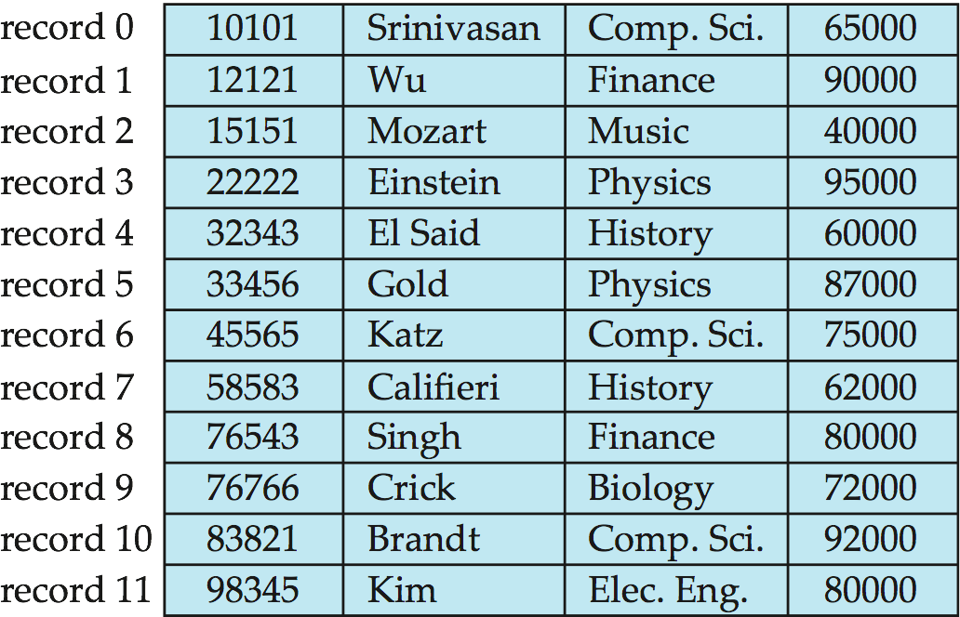
Fixed-Length Records
Simple approach:
Store record i starting from byte n ∗ (i – 1), where n is the size of each record.
Record access is simple but records may cross blocks
Modification: do not allow records to cross block boundaries
For unspanned fixed blocking, Bfr = ⎣B/R⎦ where B is the block size and R is the record size
Deletion of record i: alternatives:
move records i + 1, . . ., n to i, . . . , n – 1
move record n to i
do not move records, but link all free records on a free list
Notes:
Bagaimana cara menata record yg panjang nya FIX, tetap.
Unspanned = tidak direncanakan
CONTOH-CONTOH selanjutnya akan menggunakan FIXED LENGTH, seperti yg disampaikan di slide di atas.
IMPLEMENTASI untuk FIXED Length record. Untuk yg VAR, dijelasin di slide selanjutnya

Slide 28
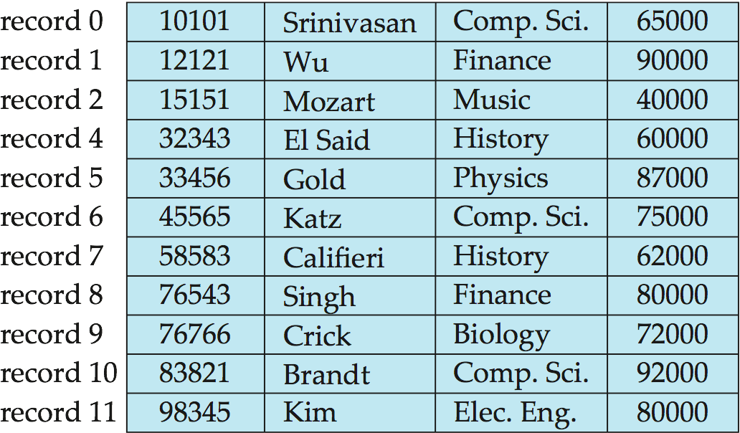
1. Deleting record 3 and compacting

Slide 29
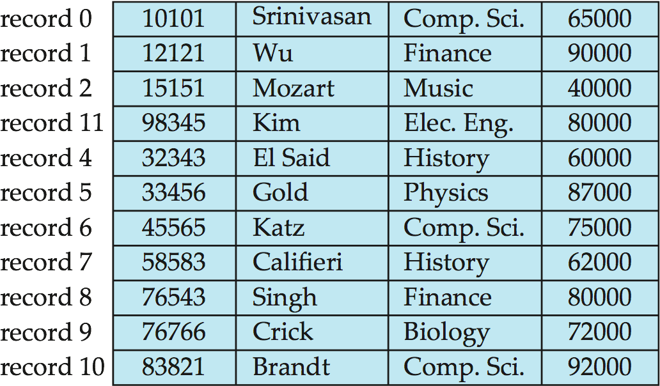
2. Deleting record 3 and moving last record

Slide 30
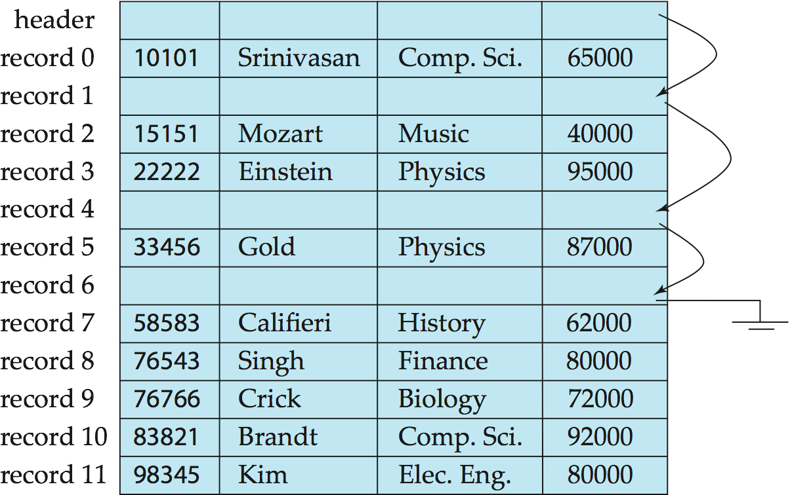
3. Free Lists
Store the address of the first deleted record in the file header.
Use this first record to store the address of the second deleted record, and so on
Can think of these stored addresses as pointers since they “point” to the location of a record.
More space efficient representation: reuse space for normal attributes of free records to store pointers. (No pointers stored in in-use records.)
Notes:
Pada metode ketiga ini tidak dilakukan geser menggeser,
Ada DAFTAR tempat kosong
Digunakan LIST utk mendaftar alamat-alamat mana yg tersedia jika akan ada record baru yg akan dimasukkan.
Kalo ada record baru mau masuk, tinggal ambil tempat dimana HEADER MENUNJUK.
Artinya kalo pake LIST, harus buat LIST, bikin cara bacanya gimana, dsb.

Slide 31
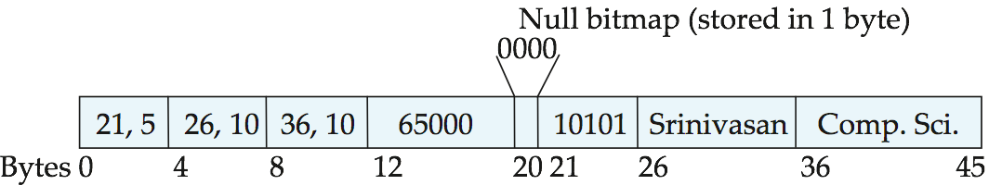
Variable-Length Records
Variable-length records arise in database systems in several ways:
Storage of multiple record types in a file.
Record types that allow variable lengths for one or more fields such as strings (varchar)
Record types that allow repeating fields (used in some older data models).
Attributes are stored in order
Variable length attributes represented by fixed size (offset, length), with actual data stored after all fixed length attributes
Null values represented by null-value bitmap
Notes:
VAR RECORD dapat terjadi jika: mengandung data variable (VAR), kolom mengandung multiple value.
Adanya VAR-length ini karena ada tipe data VARCHAR, yg size nya beda
Intinya adalah, bagaimana VAR-length ini bias diekstrak secara mudah dengan cara yg efisien

Slide 32
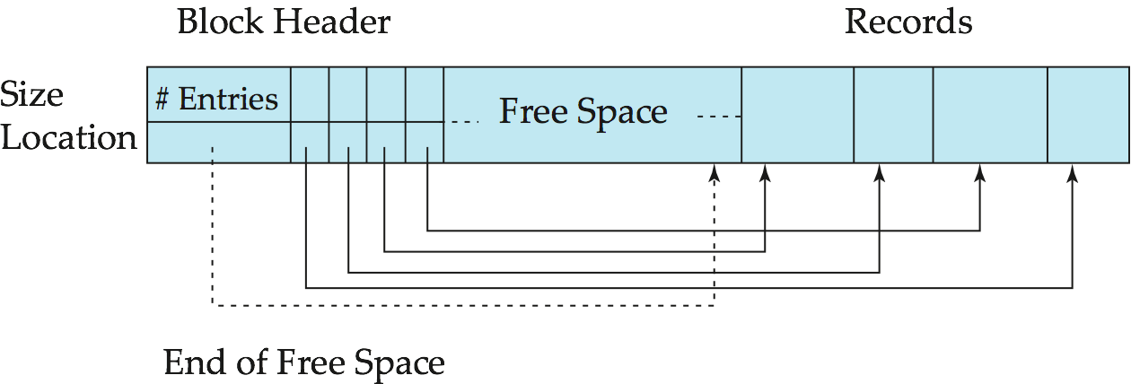
Variable-Length Records: Slotted Page Structure
Slotted page header contains:
number of record entries
end of free space in the block
location and size of each record
Records can be moved around within a page to keep them contiguous with no empty space between them; entry in the header must be updated.
Pointers should not point directly to record — instead they should point to the entry for the record in header.
Notes:
Ada HEADER dengan POINTER, karna panjangnya bisa bisa bervariasi
Slotted page header mengandung: jumlah record, free space, lokasi dan size masing2 record.
Kalo ga ada Slotted page header, RECORD tidak bisa diambil/diketahui.
Free space contigu.
Record ditaruh berurutan dari belakang, record berikutnya ditaruh didepannya, begitu seterusnya sampai block penuh.

Slide 33
File Performance Parameters
R: The amount of storage required for a record
T_{F}: The time needed to fetch an arbitrary record from the file
T_{N}: The time needed to get the next record within the file
T_{I}: The time required to update the file by inserting a record
T_{U}: The time required to update the file by changing a record
T_{X}: The time needed for exhaustive reading of the entire file
T_{Y}: The time needed for reorganization of the file
Notes:
- Arbitrary record = record acak (semaunya mau ambil record yg mana, tidak musti skuensial)
Parameter2 untuk melihat kinerja file
- R: Ukuran record
- TF: waktu yg diperlukan untuk menangkap rekord (arbitary record: rata-rata).
- Waktu yg diperlukan untuk menangkap next record dari file
- TI : waktu yang diperlukan jika ada perubahan by INSERT
- TU: waktu yg dibutuhkan utk perubahan by UPDATE
- TX: Waktu baca semua record pada file
- TY: waktu yg dibutuhkan utk re organisasi file. jika ada yg bolong-bolong.

Slide 34
Record Size
Beside the data, a record may also stores descriptive and access information.
Descriptive information is advantageous when storing heterogeneous data.
Notes:
Advantageous = berguna
Jumlah record perlu informasi, memberikan keuntungan jika menyimpan data heterogen.
INFO record size disimpan FAT (File Allocation Table): berisi bagaimana cara akses data, deskripsi data (keterangan).

Slide 35
Fetch A Record
To be able to use data from a file, a record containing the data has to be read into the memory.
Fetch is an associative retrieval of a data element based on a key value.
Fetching a record consists of 2 steps:
Locating the position of the record
The actual reading
In general, the records of a file cannot be directly located on the basis of a subscript value or record number
Therefore, a simple address computation cannot be performed
Notes:
Nangkap data TF TN, dan dipindah ke memory
Bagaimana cara nangkap suatu record? ya harus punya KEY yg unik.
Secara umum record itu ga punya nomor, jadi kalo mau akses record dg mudah ya caranya dg menulusuri satu persatu

Slide 36
Get the Next Record
Information is mainly generated by relating one fact with another; this implies getting the next record according to some criterion.
Get-Next is a retrieval using a structural dependency.
A successor record can be obtained most rapidly when related data is kept together; that is, when the locality of these data is strong.
When the records are not physically ordered according to the criterion, Get-Next is time consuming.
Notes:
Data biasanya disimpan berkelompok berdasarkan kriteria tertentu. Ada successor ada predecessor.
Jika secara fisik disimpan pada tempat yg berbeda, maka mencari record selanjutnya akan memakan banyak waktu.
Implies = menunjukkan / berarti
can be obtained most rapidly = dapat diperoleh dengan cepat

Slide 37
Insert A Record
Most applications require regular insertion of new data records into their files to remain up to date.
Inserting a record comprises of:
Locating the block where the record will be inserted
Reading the block
Rewriting the changed block
When a record has to be put in a specific place within the file, other records may have to be shifted or modified.
Insertions to the end of the file, Append, are easier to handle.
If the address of the last block of the file is known, the performance of this operation can be improved.
Notes:
Setiap perangkat lunak secara regular menambahkan data record kedalam sebuah file, agar perangkat lunak itu selalu dalam keadaan UP TO DATE.
INSERT (tambah, SISIP) juga belum tentu dengan mudah, mungkin saja INSERT perlu menggeser record lain.
MASALAH: Mencari lokasi tenpat yg kosong. sebaiknya didekat tempat yg sejenis.
Alokasi BLOCK, dimana record baru itu ditempatkan
Read block, untuk mencari letak persis nya
rewrite block dg record yg baru
Kondisi spesifik, bila perlu harus menggeser record lain (misalnya supaya URUT), atau modifikasi file supaya bisa geser (misalnya modifikasi alamat).
Lebih mudah memang menaruh record baru di akhir FILE.
Comprises = meliputi / mengandung

Slide 38
Update A Record
All changes of data do not require insertion of a new record.
When data within a stored record must be changed, the new, updated record is created.
The old data and the changes are merged to create a new record,
The new record is inserted into the position of the old record within the block, and
The block is rewritten into the file.
If the record has grown in size, it may not be possible to use the old position → delete the old record and insert a new one.
Deleting a record is not performed immediately, but instead the record to be deleted is marked with an indicator that the record is now invalid → the delete is now converted to an update.
Notes:
Perubahan terjadi sebagian.
Harus melihat old dan new data
BLOCK main memori, old ditimpah new data.
Variabel-length: SIZE nya membesar, delete old, insert tempat baru.
the delete is now converted to an update = maksudnya mengupdate status record, bahwa record tersebut sekarang tidak valid
Update record tidak semudah itu, perlu juga memikirkan apabila UPDATE membutuhkan ruang yg lebih besar. Ini akan jadi rumit bila record berada di TENGAH, dan tidak memungkinkan record lain untuk digeser (missal block itu udah penuh, maka ga ada cara lain selain pindah ke block lain).

Slide 39
Organisasi file

Slide 40
Reorganize the File
Reorganization removes deleted and invalidated records, reclaims the space for new data, and restores clustering.
It is especially important for file organizations which create tombstones for deletion and updates.
Its frequency depends on the type of file organization used but varies greatly with the application.
It has many similarities with “garbage collection”.
Notes:
Reorganize file ini seringkali bergantung pada file system, tapi sebenarnya lebih bergantung pada aplikasi (daripada SO). Contoh pada update PK, si apps (MySQL) yg akan mengatur organisasi file nya.
KENAPA? Ini karena SO hanya berkepentingan bagaimana file disimpan didalam stroge, TIDAK pada optimasinya.
Nah, di slide selanjutnya kita akan bicara cara-cara apa saja yg bisa dipake
Tombstones = batu nisan (tanda sudah dihapus)

Slide 41
Organization of Records in Files
Heap – a record can be placed anywhere in the file where there is space
Sequential – store records in sequential order, based on the value of the search key of each record
Hashing – a hash function computed on some attribute of each record; the result specifies in which block of the file the record should be placed
Records of each relation may be stored in a separate file. In a multitable clustering file organization records of several different relations can be stored in the same file
Motivation: store related records on the same block to minimize I/O
Notes:
Heap = taruh disembarang tempat yg masih kosong pada FILE
Squential = ditaruh berurutan pada FILE, berdasarkan kata kunci tertentu
Hashing = Dapet alamat record berdasarkan hitungan rumus KEY tertentu
multitable clustering file organization = umumnya beda file jika beda relasi. Tapi untuk record yg punya relasi, bisa disimpan dalam block yg sama.

Slide 42
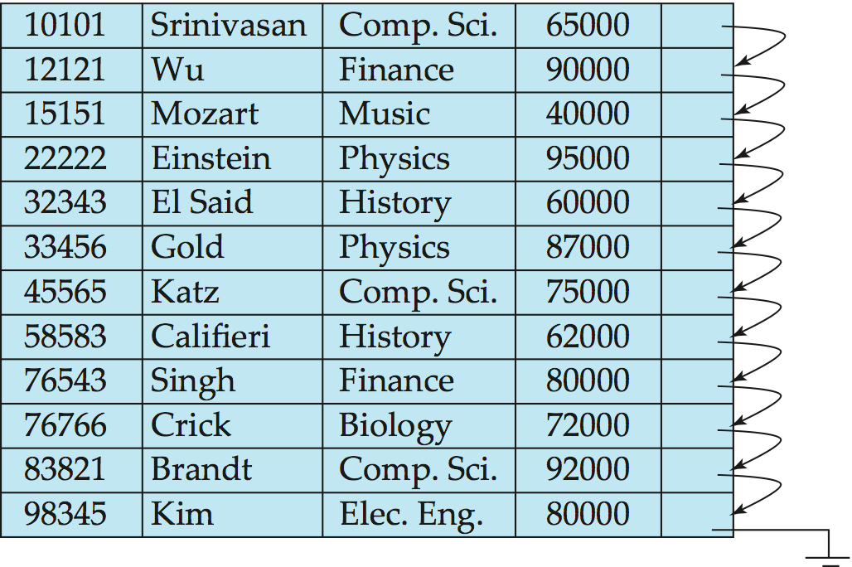
Sequential File Organization
Suitable for applications that require sequential processing of the entire file
The records in the file are ordered by a search-key
Pointer
Notes:
Satu dengan lain dihubungkan dengan pointer
Kenapa? Apa g bisa langsung aja ditelusuri samping nya secara squensial? Jawaban dari pertanyaan ini ada di slide selanjutnya
Yaitu pada kasus delete, akan ada record yg tidak squensial, nah masa inilah pointer akan sangat dibutuhkan

Slide 43
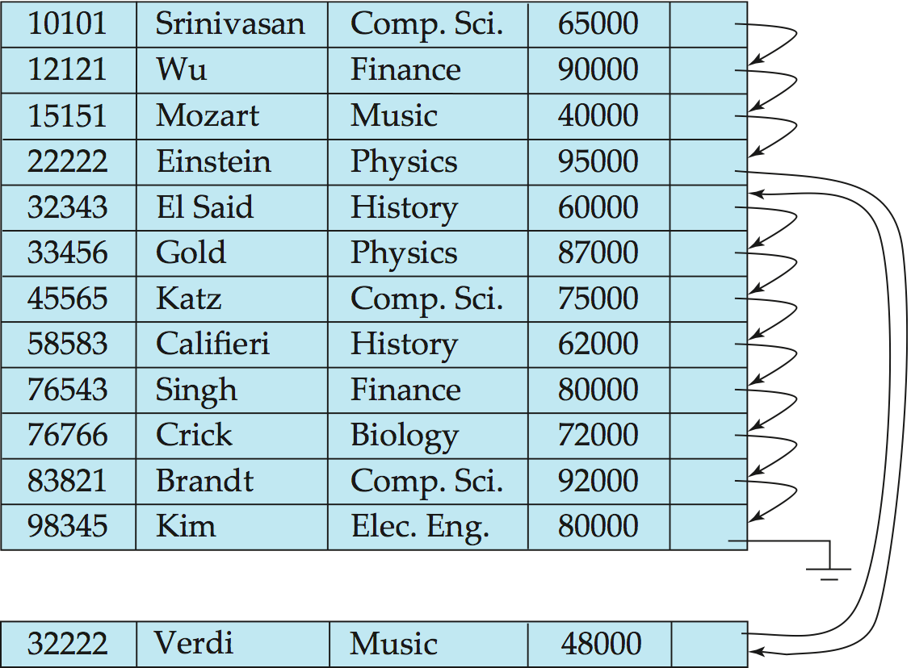
Sequential File Organization (Cont.)
Deletion – use pointer chains
Insertion – locate the position where the record is to be inserted
if there is free space insert there
if no free space, insert the record in an overflow block
In either case, pointer chain must be updated
Need to reorganize the file from time to time to restore sequential order
Notes:
Overflow = bermakna ujung (diujung table, tapi dihubungkan dengan pointer)
32222 lebih kecil dari 32343, oleh karena itu pointer dapat berperan baik disini, karna tidak perlu geser record 32343…n

Slide 44
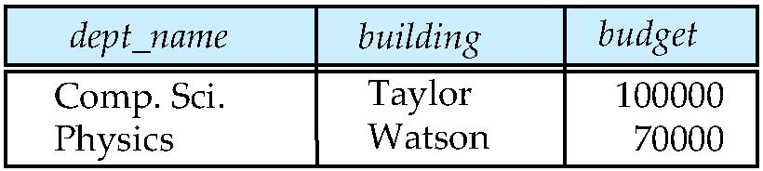
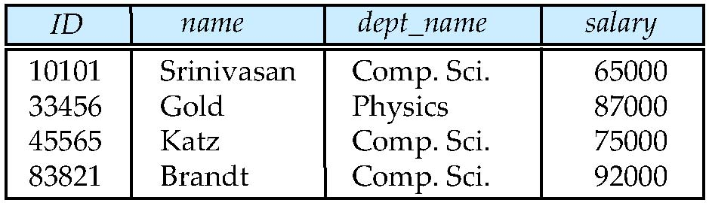
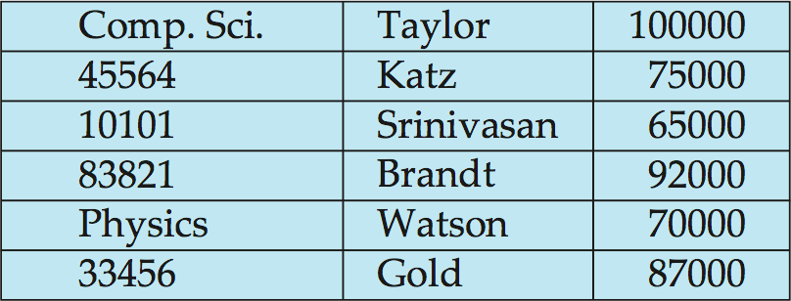
Multitable Clustering File Organization
Store several relations in one file using a multitable clustering file organization
department
instructor
batas
multitable clustering
of department and
instructor
batas
Notes:
Dalam suatu organisasi, biasanya seseorang itu ada di suatu divisi, nah NAMA divisi inilah yang akan digunakan sebagai penghubung antar dua tabel

Slide 45
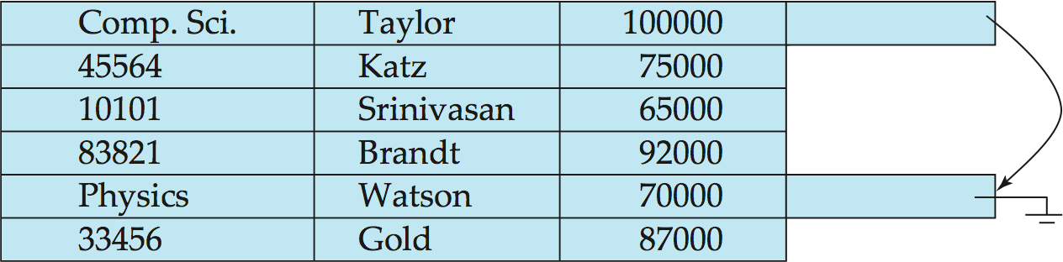
Multitable Clustering File Organization (cont.)
good for queries involving the join of department and instructor, and for queries involving one single department and its instructors
bad for queries involving only department
results in variable size records
Can add pointer chains to link records of a particular relation
Notes:
bad for queries involving only department = karna ketika mau nampilkan department, harus melewati banyak record instructor (yg tidak diperlukan dalam kasus ini)

Slide 46
Data Dictionary Storage
The Data dictionary (also called system catalog) stores metadata; that is, data about data, such as:
Information about relations
names of relations
names, types and lengths of attributes of each relation
names and definitions of views
integrity constraints
User and accounting information, including passwords
Statistical and descriptive data
number of tuples in each relation
Physical file organization information
How relation is stored (sequential/hash/…)
Physical location of relation
Information about indices
Notes:
DBMS perlu memantain data ttg relasi. Misalnya: skema antar relasi.

Slide 47
Use of Index
Indexing mechanisms used to speed up access to desired data.
E.g., author catalog in library
Search Key - attribute to set of attributes used to look up records in a file.
An index file consists of records (called index entries) of the form
Index files are typically much smaller than the original file
Two basic kinds of indices:
Ordered indices: search keys are stored in sorted order
Hash indices: search keys are distributed uniformly across “buckets” using a “hash function”.
search-key
pointer
Notes:
Implementasi index yaitu sebuah file yang terpisah dari file relasi asli
Biasanya ukurannya lebih kecil dari file relasi asli
Uniformly = merata

Slide 48
Index Evaluation Metrics
Access types supported efficiently. E.g.,
Find records with a specified value in the attribute
or records with an attribute value falling in a specified range of values.
Access time
Insertion time
Deletion time
Space overhead
Notes:
Access type : bagaimana sebuah algoritma indexing dapat mendukung tipe access (by value, atau range) secara efisien
Access time : waktu yang dibutuhkan untuk menemukan sebuah data, kumpulan data,
Insertion time : waktu yang dibutuhkan utk menemukan tempat yang tepat utk sebuah record. Termasuk didalamnya adalah waktu utk mengubah struktur index.
Deletion time : waktu yang diperlukan untuk menemukan data, kemudian menghapusnya, termasuk waktu utk mengupdate struktur index.
Space overhead: ruang tambahan yang dibutuhkan. Tidak mengapa asalkan memberikan efek peningkatan kinerja yg baik.
Space overhead : terjadi pada HASHING.

Slide 49
Ordered Indices
In an ordered index, index entries are stored sorted on the search key value. E.g., author catalog in library.
Primary index: in a sequentially ordered file, the index whose search key specifies the sequential order of the file.
Also called clustering index
The search key of a primary index is usually but not necessarily the primary key.
Secondary index: an index whose search key specifies an order different from the sequential order of the file. Also called non-clustering index.
Index-sequential file: ordered sequential file with a primary index.
Notes:
Ordered index = entri indeks yang tersimpan diurutkan pada nilai kunci pencarian
Primary index = search key pada primary key
Secondary index = tidak sequential, lihat slide selanjutnya. Tidak mengacu pada kunci pencarian UTAMA.

Slide 50
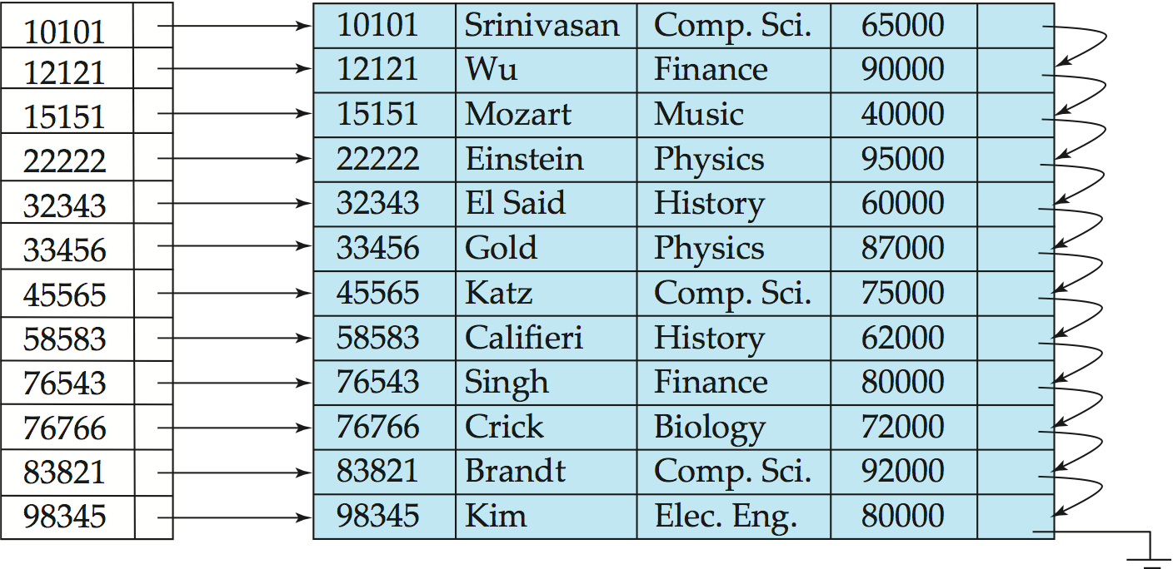
Dense Index Files
Dense index — Index record appears for every search-key value in the file.
E.g. index on ID attribute of instructor relation
Notes:
Terdiri dari search key dan pointer yang mengarah ke record tertentu

Slide 51
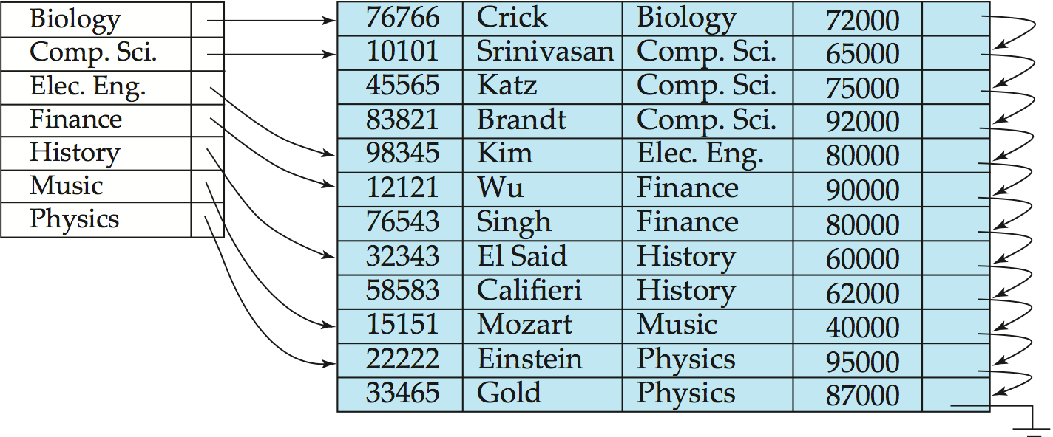
Dense Index Files (Cont.)
Dense index on dept_name, with instructor file sorted on dept_name
Notes:
Sepertinya sama dengan SPARSE index, tetapi kalo dilihat lebih detail, maka ini bukan clustering. Search key menunjukan kepada DEPARTMEN NAME

Slide 52
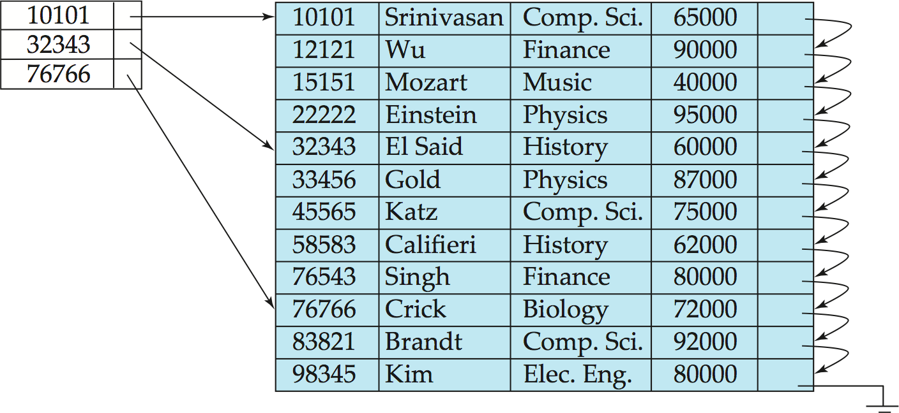
Sparse Index Files
Sparse Index: contains index records for only some search-key values.
Applicable when records are sequentially ordered on search-key
To locate a record with search-key value K we:
Find index record with largest search-key value < K
Search file sequentially starting at the record to which the index record points
Notes:
Kluster, pointer menunjuk kepada HEAD of KELOMPOK record

Slide 53
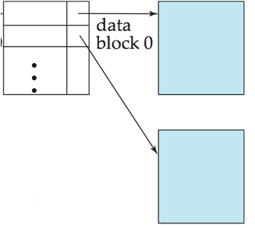
Sparse Index Files (Cont.)
Compared to dense indices:
Less space and less maintenance overhead for insertions and deletions.
Generally slower than dense index for locating records.
Good tradeoff: sparse index with an index entry for every block in file, corresponding to least search-key value in the block.
Notes:
Less space and less maintenance overhead for insertions and deletions. = Kalo sparse ini dia harus ngecek batas record anggota tiap kategori tuh dimana, jangan sampe keliwat

Slide 54
Secondary Indices Example
Secondary index on salary field of instructor
Index record points to a bucket that contains pointers to all the actual records with that particular search-key value.
Secondary indices have to be dense
Notes:
54

Slide 55
Primary and Secondary Indices
Indices offer substantial benefits when searching for records.
BUT: Updating indices imposes overhead on database modification --when a file is modified, every index on the file must be updated,
Sequential scan using primary index is efficient, but a sequential scan using a secondary index is expensive
Each record access may fetch a new block from disk
Block fetch requires about 5 to 10 milliseconds, versus about 100 nanoseconds for memory access
Notes:
55
Imposes = menyebabkan

Slide 56
Multilevel Index
If primary index does not fit in memory, access becomes expensive.
Solution: treat primary index kept on disk as a sequential file and construct a sparse index on it.
outer index – a sparse index of primary index
inner index – the primary index file
If even outer index is too large to fit in main memory, yet another level of index can be created, and so on.
Indices at all levels must be updated on insertion or deletion from the file.

Slide 57
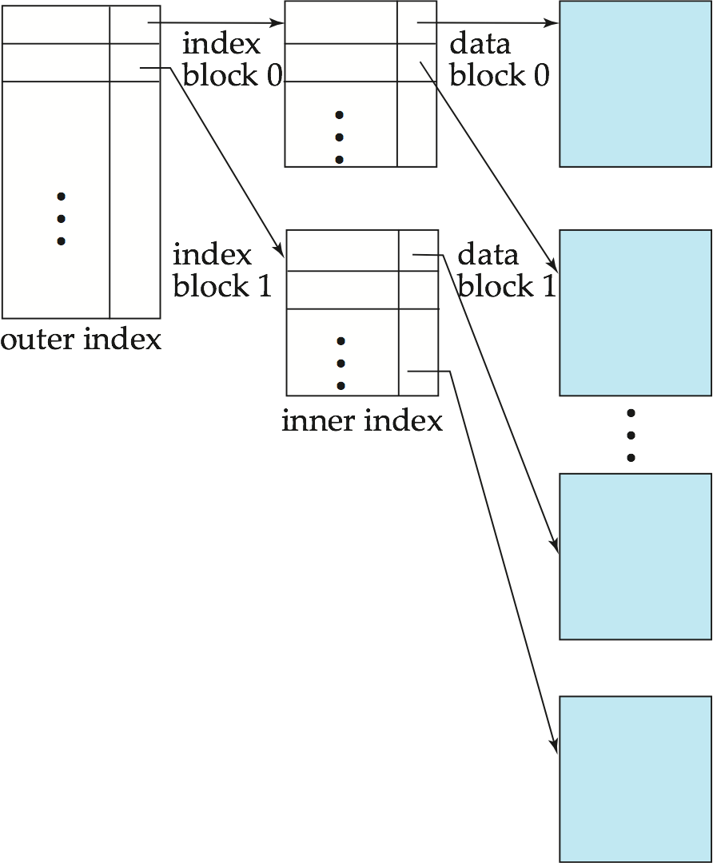
Multilevel Index (Cont.)

Slide 58
Index Update: Deletion
If deleted record was the only record in the file with its particular search-key value, the search-key is deleted from the index also.
Single-level index entry deletion:
Dense indices – deletion of search-key is similar to file record deletion.
Sparse indices –
if an entry for the search key exists in the index, it is deleted by replacing the entry in the index with the next search-key value in the file (in search-key order).
If the next search-key value already has an index entry, the entry is deleted instead of being replaced.

Slide 59
Index Update: Insertion
Single-level index insertion:
Perform a lookup using the search-key value appearing in the record to be inserted.
Dense indices – if the search-key value does not appear in the index, insert it.
Sparse indices – if index stores an entry for each block of the file, no change needs to be made to the index unless a new block is created.
If a new block is created, the first search-key value appearing in the new block is inserted into the index.
Multilevel insertion and deletion: algorithms are simple extensions of the single-level algorithms
Notes:
- Kalo udah ada blok, nggak perlu buat KEY BARU

